Slide 1

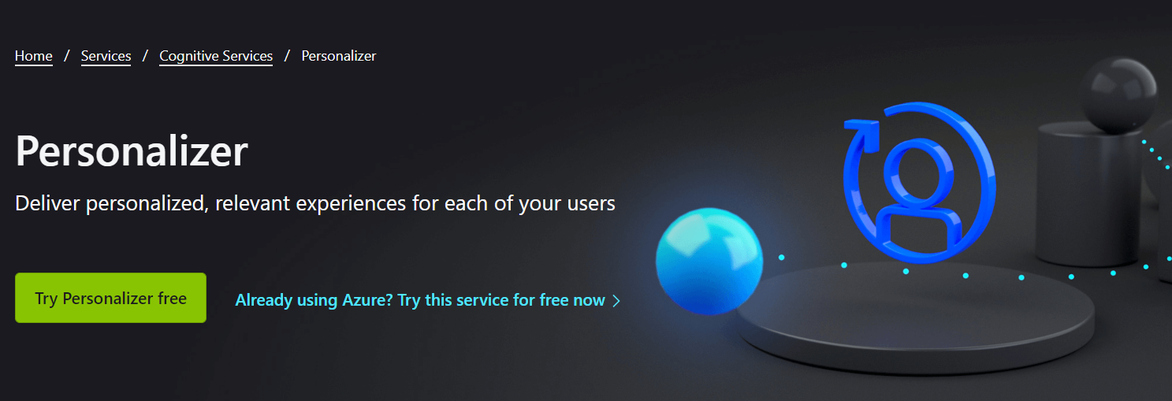
Real World RL with VW 9.2 & Azure Personalizer
ICML 2022 Expo Day 7/17
VW contributors & APS team

Slide 2
What is Vowpal Wabbit?
Open Source
Online learning
Interactive Reinforcement
What is Azure Personalizer Service?
+High availability
+Perfect logging
+Reporting
+…

Slide 3
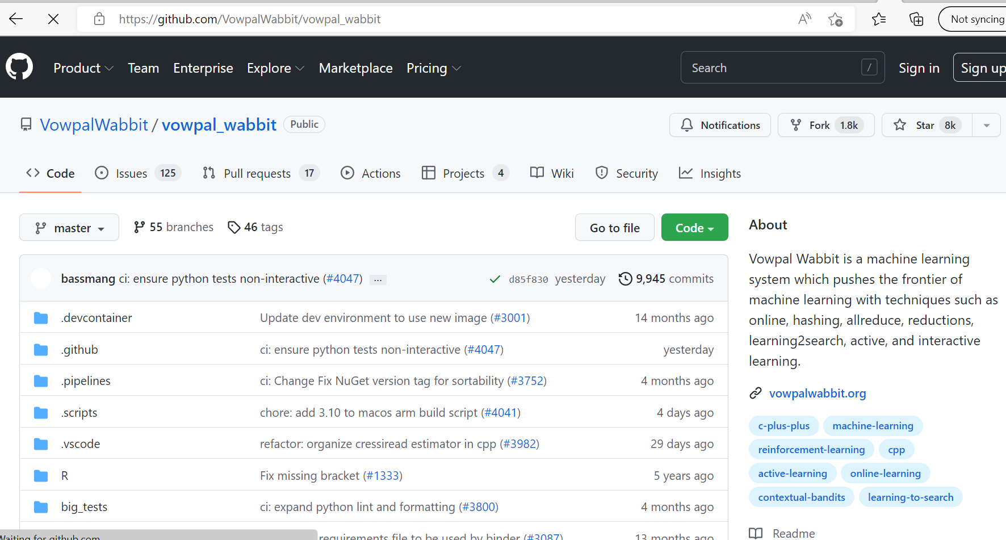
Open Source: Tweak, improve, play. BSD License

Slide 4

Online Learning: Adapt!
Progressive Validation
Rapid Adaptation
Sublinear debug

Slide 5

Interactive Reinforcement
Single Sample Update
Natural Feedback
+Active Learning
Action
Policy ?
Observation
Reward

Slide 6
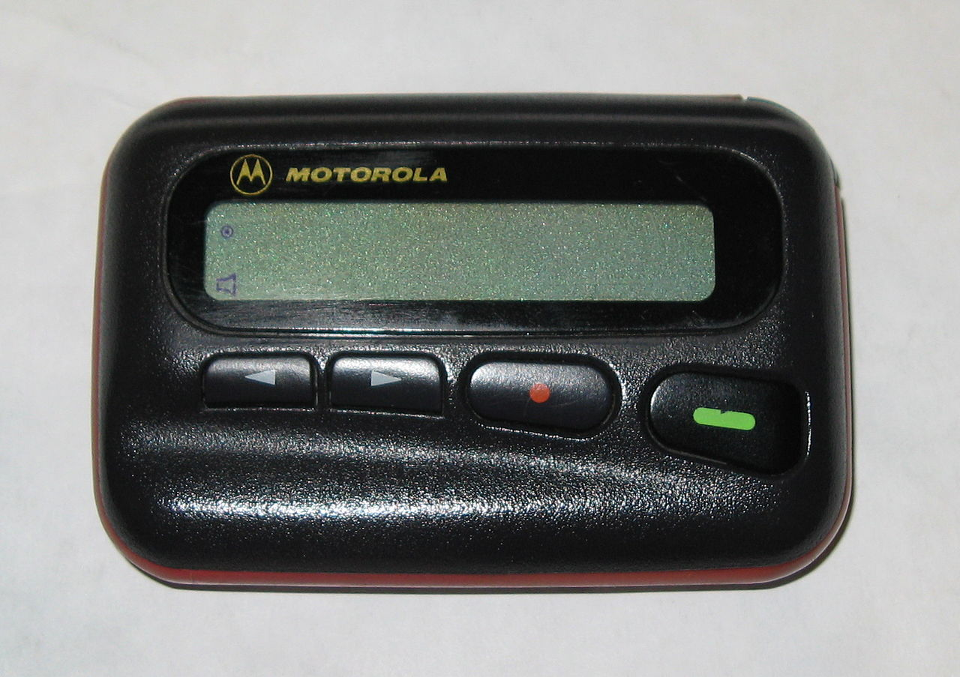
High Availability: Who wears the beeper?

Slide 7
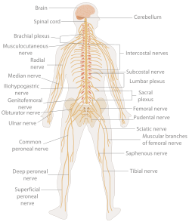
Logging: Always get the right data to learn from

Slide 8
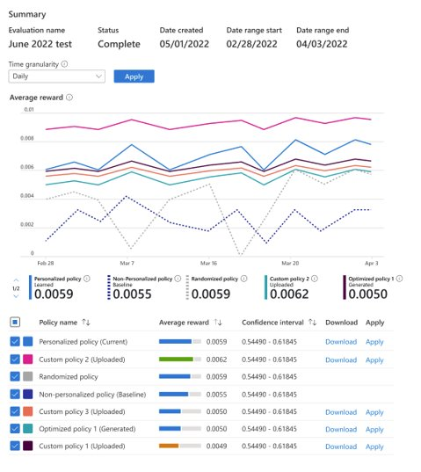
Reporting: What’s going on?

Slide 9
The plan for the day
12:10-12:50 Anatomy of Vowpal Wabbit & Reductions Cookbook
12:50-1:05 Break
1:05-1:50 What is new in Vowpal Wabbit 9
1:50-2:05 Break
2:05-2:50 Azure Personalizer Service (VW-as-a-service)

